Slide 1
HTTP
Header format, protocol details, RESTful API, functions libraries for HTTP communication
Online Material

Slide 2
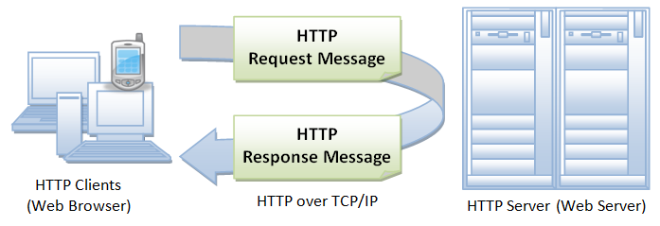
HyperText Transfer Protocol - HTTP
HTTP is an asymmetric request-response client-server protocol as illustrated.
Stateless
Permits negotiation of data type and representation
http://www.ntu.edu.sg/home/ehchua/programming/webprogramming/http_basics.html

Slide 3
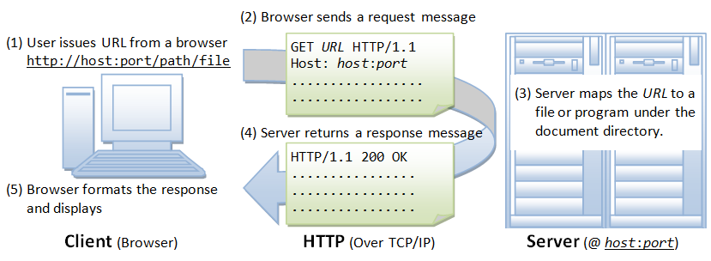
HyperText Transfer Protocol - HTTP
http://www.ntu.edu.sg/home/ehchua/programming/webprogramming/http_basics.html

Slide 4
Uniform Resource Locator - URL
protocol://hostname:port/path-and-file-name
Protocol: The application-level protocol used by the client and server, e.g., HTTP, FTP, and telnet.
Hostname: The DNS domain name (e.g., www.nowhere123.com) or IP address (e.g., 192.128.1.2) of the server.
Port: The TCP port number that the server is listening for incoming requests from the clients.
Path-and-file-name: The name and location of the requested resource, under the server document base directory.
http://www.ntu.edu.sg/home/ehchua/programming/webprogramming/http_basics.html

Slide 5
URI, URL, URN
Uniform Resource Identifier
URIs are a standard for identifying documents using a short string of numbers, letters, and symbols [RFC 3986]. URLs, URNs, and URCs are all types of URI.
Uniform Resource Locator
Contains information about how to fetch a resource from its location.
Uniform Resource Name
Identifies a resource by a unique and persistent name but doesn't necessarily tell you how to locate it on the internet. It usually starts with the prefix urn:
Uniform Resource Citation
Meta data about a document rather than to the document itself.
https://stackoverflow.com/questions/176264/what-is-the-difference-between-a-uri-a-url-and-a-urn

Slide 6
HyperText Markup Language - HTML
HTML stands for Hyper Text Markup Language
HTML describes the structure of Web pages using markup
HTML elements are the building blocks of HTML pages
HTML elements are represented by tags
HTML tags label pieces of content such as "heading", "paragraph", "table", and so on
Browsers do not display the HTML tags, but use them to render the content of the page
https://www.w3schools.com/html/html_intro.asp

Slide 7
HTTP Request
url => http://www.nowhere123.com/doc/index.html
Client
Server
GET /docs/index.html HTTP/1.1
Host: www.nowhere123.com
Accept: image/gif, image/jpeg, */*
Accept-Language: en-us Accept-Encoding: gzip, deflate
User-Agent: Mozilla/4.0 (compatible; MSIE 6.0; Windows NT 5.1)
(blank line)

Slide 8
HTTP Response
url => http://www.nowhere123.com/doc/index.html
Client
Server
HTTP/1.1 200 OK
Date: Sun, 18 Oct 2009 08:56:53 GMT
Server: Apache/2.2.14 (Win32)
Last-Modified: Sat, 20 Nov 2004 07:16:26 GMT
ETag: "10000000565a5-2c-3e94b66c2e680"
Accept-Ranges: bytes
Content-Length: 44
Connection: close
Content-Type: text/html
X-Pad: avoid browser bug
<html><body><h1>It works!</h1></body></html>
Note: New-lines

Slide 9
Example: Wireshark, browser
GET /marc/ HTTP/1.1[CRLF] Host: 194.47.151.125[CRLF] Connection: keep-alive[CRLF] Upgrade-Insecure-Requests: 1[CRLF] User-Agent: Mozilla/5.0 (Windows NT 10.0; Win64; x64) AppleWebKit/537.36 (KHTML, like Gecko) Chrome/70.0.3538.110 Safari/537.36[CRLF] Accept: text/html,application/xhtml+xml,application/xml;q=0.9,image/webp,image/apng,*/*;q=0.8[CRLF] Accept-Encoding: gzip, deflate[CRLF] Accept-Language: sv-SE,sv;q=0.9,en-US;q=0.8,en;q=0.7,de;q=0.6,ru;q=0.5[CRLF] Cookie: PHPSESSID=u2vkjd7lxyxyxyxyxyxyxyxyx30[CRLF] [CRLF] HTTP/1.1 200 OK[CRLF] Date: Thu, 06 Dec 2018 08:37:06 GMT[CRLF] Server: Apache/2.4.7 (Ubuntu)[CRLF] X-Powered-By: PHP/5.5.9-1ubuntu4.6[CRLF] Expires: Thu, 19 Nov 1981 08:52:00 GMT[CRLF] Cache-Control: no-store, no-cache, must-revalidate, post-check=0, pre-check=0[CRLF] Pragma: no-cache[CRLF] Vary: Accept-Encoding[CRLF] Content-Encoding: gzip[CRLF] Content-Length: 1649[CRLF] Keep-Alive: timeout=5, max=99[CRLF] Connection: Keep-Alive[CRLF] Content-Type: text/html[CRLF] [CRLF] ...........Y[o.6.~N~..a{Yu...".s....tA..(.a.%.bB.*E.._.CIv.9..4.........~.B..~8......[...[CRLF] .=}A...o.n.\.h..~.....)..m{6.Y..%..v{..=..........z..Da..M.9.S.8.\....EB...O...\.z.1[CRLF] ",S....wf.@v..(.C.0.H...4"D.H.H96HS.E..}....t...Zy....~..\..5].g5. K.......HH.d[CRLF] Q.....xB..Y..*.x...J.=.S-`...7[CRLF] $M....x..V..2X.z.....V3..65..].?...y?..uKB...<...Y c..d.^e_.7.L.....bd.....w.....1..A.x.".D.Cy....$.]d...D..7.^H.....R....w...!N. ..[tl..4ax.G\pr.. .'./M0G..)d".F..*.&fD.... .....:F0. .}..N2G[CRLF] ....|~.w.U....N...`.. ...Y....q..V..E...%.(...<.2`y.......+0..r...@..~.K.@}Aj;N...7-.1x.8;).h<Y.?..HE.4...db ......*.[CRLF] P..D...V...H..c>o4....[CRLF] ...[CRLF] .....z`%Q.0.Q.T|..Rr...p[CRLF] zO8.XQp..c.H)D].t....\............xD$..[.d.d......C.C2....&b......v.........)o..i.P.g.=.......F....f. ..W6....J_...'.2Y....OL. }...L..+".DBz....d....m...t........F.8.{P...p.'._.S.......O//..?8.$..)4.I..Q).:.$.. '.'IS...h9,..........K.z...1......Y.%X.........!.)./.&.@..........H(X-....*..*z..Z.^\.....^\..g.'.P.}...-..A.z.M4Y.B....R..j].....`.......{....o>.kxFW..DRp.O^....+1V3X4..Pb@azO#.@.....n2%.X..o`.."S.U<.,.._...............N..Z6.....[.VE..e..X...Xn...B3B.R.'....e...PJ....H.D ..X...'..,....9....Q"...y.z..i.u..R..P.t...Z2.N....@..)'!....G..Z..... NT&.........JL.Q.L..V......qq........q.-5n.h.5 QGM....b..qw0..5.t*smv.L...i?..=.L....[h..5...JG...|m.}z..A..8....t."....lT.F.~ r..'J.N.Y..#Yi6..X.........$O......p.3 R.Lc....@/M....~.n.+ R./.M.../{-C0........n..n.O..|g..L..v.~......-..]{.....5vP.E...BM.......}.q...^.W2u......x.v^d;....t+3.D..t.E../M/.V='..}..K...........>.,.C7.F.B.....<c....;..G..".....j..)W8.s.@.C..S.D?......1..J.;4.L.'E...j....c...;p.Ag<UTe. 1F.$..`b.X.[M....B.]|~...'......
Client, request
Server, response
1659
bytes
gzip

Slide 10
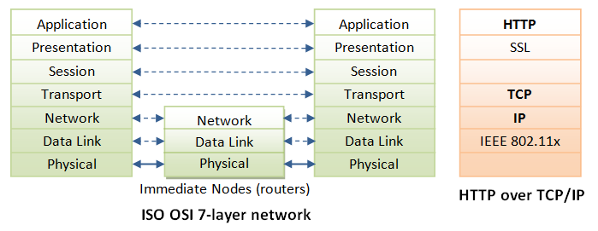
HTTP in TCP/IP

Slide 11
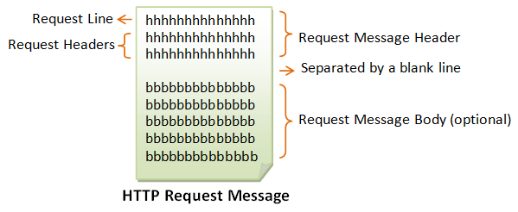
HTTP Request and Response Messages

Slide 12
Request Line
request-method-name request-URI HTTP-version
request-method-name: HTTP protocol defines a set of request methods, e.g., GET, POST, HEAD, and OPTIONS. The client can use one of these methods to send a request to the server.
request-URI: specifies the resource requested.
HTTP-version: Three versions are currently in use: HTTP/1.0, HTTP/1.1 and HTTP/2.0. [HTTP/3.0 in the works]
GET /test.html HTTP/1.1
HEAD /query.html HTTP/1.0
POST /index.html HTTP/1.1

Slide 13
Request Headers
request-header-name: request-header-value1, request-header-value2, ...
name:value pairs.
Multiple values, separated by commas, can be specified.
Host: www.xyz.com
Connection: Keep-Alive Accept: image/gif, image/jpeg, */*
Accept-Language: us-en, fr, cn

Slide 14
Example
Request line
GET /marc/ HTTP/1.1[CRLF] Host: 194.47.151.125[CRLF] Connection: keep-alive[CRLF] Upgrade-Insecure-Requests: 1[CRLF] User-Agent: Mozilla/5.0 (Windows NT 10.0; Win64; x64) AppleWebKit/537.36 (KHTML, like Gecko) Chrome/70.0.3538.110 Safari/537.36[CRLF] Accept: text/html,application/xhtml+xml,application/xml;q=0.9,image/webp,image/apng,*/*;q=0.8[CRLF] Accept-Encoding: gzip, deflate[CRLF] Accept-Language: sv-SE,sv;q=0.9,en-US;q=0.8,en;q=0.7,de;q=0.6,ru;q=0.5[CRLF] Cookie: PHPSESSID=u2vkjd7lxyxyxyxyxyxyxyxyx30[CRLF]
[CRLF]
Response Headers
Request
header
Blank line, separates request from body (if present)

Slide 15
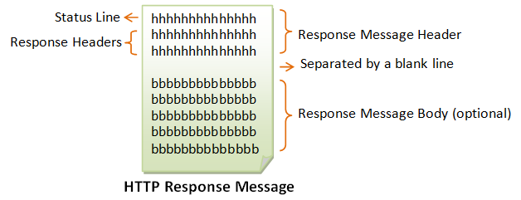
HTTP Response

Slide 16
Status Line
HTTP-version status-code reason-phrase
HTTP-version: The HTTP version used in this session. Either HTTP/1.0 and HTTP/1.1.
status-code: a 3-digit number generated by the server to reflect the outcome of the request.
reason-phrase: gives a short explanation to the status code.
Common status code and reason phrase are "200 OK", "404 Not Found", "403 Forbidden", "500 Internal Server Error".

Slide 17
HTTP Response Codes
1xx Informational response
2xx Success
200 OK
3xx Redirection
301 Moved Permanently
4xx Client Error
400 Bad Request
404 Not Found
5xx Server Error
500 Internal Server Error
https://en.wikipedia.org/wiki/List_of_HTTP_status_codes

Slide 18
Response Headers
response-header-name: response-header-value1, response-header-value2, ...
name:value pairs.
Multiple values, separated by commas, can be specified.
Content-Type: text/html
Content-Length: 35
Connection: Keep-Alive
Keep-Alive: timeout=15, max=100

Slide 19
Response Example
Status Line
HTTP/1.1 200 OK[CRLF]
Date: Thu, 06 Dec 2018 08:37:06 GMT[CRLF]
Server: Apache/2.4.7 (Ubuntu)[CRLF]
X-Powered-By: PHP/5.5.9-1ubuntu4.6[CRLF]
Expires: Thu, 06 Dec 2018 08:42:06 GMT[CRLF]
Cache-Control: max-age=300,public, must-revalidate[CRLF]
Content-Length: 159[CRLF]
Keep-Alive: timeout=5, max=95[CRLF]
Connection: Keep-Alive[CRLF]
Content-Type: image/png[CRLF]
[CRLF]
.PNG CRLF]
.[CRLF]
...[CRLF]
IHDR...[CRLF]
...........7.... pHYs................QIDAT(.c`..`d```................HH..96.h...+Q.X. .r...C.....y....$9.f3\..O.P......i{.5ZbJa....IEND.B`.[CRLF]
Response Headers
Blank line, separates request from body (if present)
Response
Body

Slide 20
HTTP Methods
GET
Request to get a web resource from the server.
HEAD
Request to get the header that a GET request would have obtained.
POST
Used to post data up to the web server.
PUT
Ask the server to store the data.
DELETE
Ask the server to delete the data.
CONNECT
Tell a proxy to make a connection to another host and simply reply the content, without attempting to parse or cache it.
TRACE
Ask the server to return a diagnostic trace of the actions it takes.
OPTIONS
Ask the server to return the list of request methods it supports.

Slide 21
Summary Methods
HTTP method | RFC | Request has Body | Response has Body | Safe | Idempotent | Cacheable
GET | RFC 7231 | Optional | Yes | Yes | Yes | Yes
HEAD | RFC 7231 | No | No | Yes | Yes | Yes
POST | RFC 7231 | Yes | Yes | No | No | Yes
PUT | RFC 7231 | Yes | Yes | No | Yes | No
DELETE | RFC 7231 | No | Yes | No | Yes | No
CONNECT | RFC 7231 | Yes | Yes | No | No | No
OPTIONS | RFC 7231 | Optional | Yes | Yes | Yes | No
TRACE | RFC 7231 | No | Yes | Yes | Yes | No
PATCH | RFC 5789 | Yes | Yes | No | No | No

Slide 22
A note on POST and PUT
HTTP PUT
PUT puts a file or resource at a specific URI, and exactly at that URI. If there's already a file or resource at that URI, PUT replaces that file or resource. If there is no file or resource there, PUT creates one. PUT is idempotent, but paradoxically PUT responses are not cacheable.
HTTP POST
POST sends data to a specific URI and expects the resource at that URI to handle the request. The web server at this point can determine what to do with the data in the context of the specified resource. The POST method is not idempotent; however POST responses are cacheable so long as the server sets the appropriate Cache-Control and Expires headers.

Slide 23

A note on Idempotence
“The property of certain operations in mathematics and computer science whereby they can be applied multiple times without changing the result beyond the initial application”
https://en.wikipedia.org/wiki/Idempotence

Slide 24
HTTP-based services
All service invocations use HTTP
HTTP is always the outer envelope of an invocation request and response
All service invocations use URIs as the service endpoint
The URI is the location of the service
All service invocations are a form of RPC
Regardless of technology
Some services hide behind other abstractions (REST)

Slide 25
REST Architectural Constraints
Client-Server
Separation of concerns.
Stateless
No client context being stored on the server between requests.
Cacheability
Responses must therefore, implicitly or explicitly, define themselves as cacheable or not to prevent clients from getting stale or inappropriate data in response to further requests.
Layered System
Intermediary servers improves scalability by load balancing and providing shared caches.
Uniform interface
Simplifies Architecture, enables each part to evolve independently.
Code on Demand
Servers can extend or customize the functionality of a client by transferring code, i.e. JavaScript.
(Optional)
https://en.wikipedia.org/wiki/Representational_state_transfer

Slide 26
Use HTTP Verbs to their meaning
Use GET for retrieving a resource
Use POST to create a resource
Use PUT to update a resource
Use DELETE to delete a resource
Note
GET requests must not change any underlying resource data. Measurements and tracking which update data may still occur, but the resource data identified by the URI should not change.

Slide 27
Use Sensible Resource Names(1)
Use identifiers in your URLs instead of in the query-string. Using URL query-string parameters is fantastic for filtering, but not for resource names.
Good: /users/12345
Poor: /api?type=user&id=23
Leverage the hierarchical nature of the URL to imply structure.
Design for your clients, not for your data.
Resource names should be nouns. Avoid verbs as resource names, to improve clarity. Use the HTTP methods to specify the verb portion of the request.

Slide 28
Use Sensible Resource Names(2)
Use plurals in URL segments to keep your API URIs consistent across all HTTP methods, using the collection metaphor.
Recommended: /customers/33245/orders/8769/lineitems/1
Not: /customer/33245/order/8769/lineitem/1
Avoid using collection verbiage in URLs. For example 'customer_list' as a resource. Use pluralization to indicate the collection metaphor (e.g. customers vs. customer_list).
Use lower-case in URL segments, separating words with underscores ('_') or hyphens ('-'). Some servers ignore case so it's best to be clear.
Keep URLs as short as possible, with as few segments as makes sense.

Slide 29
Hints
Use HTTP Response Codes for Status
Offer both JSON, XML and others, and in that order.
Favor JSON support unless you're in a highly-standardized and regulated industry that requires XML. Let consumers switch between formats using the HTTP Accept header.
Fine-Grained Resources
When starting out, it's best to create APIs that mimic the underlying application domain or database architecture of your system.
Consider Connectedness
APIs become more self-descriptive and discoverable when links are returned in the response.

Slide 30

Frameworks
Java
Spring
JavaScript
Express (Node.js)
Loopback (Node.js)
Restify (Node.js)
Python
Django
Flask
…
Ruby
Rails
…
C++
Pistache
Restbed
Php
Laravel
Lumen
….
Go
Revel
Gin
Rust
Rocket
Iron
Erlang
…

Slide 31
HTTP Libraries – Client Side
Curl
Highly portable, Free, Thread-safe, IPv6 compatible, ….
Beast (Boost)
Beast is a C++ header-only library serving as a foundation for writing interoperable networking libraries by providing low-level HTTP/1, WebSocket, and networking protocol vocabulary types and algorithms using the consistent asynchronous model of Boost.Asio.
CPR (Curl for People)
C++ Requests: Curl for People, a spiritual port of Python Requests. (based on libcurl)
GNU Common C++ Library
Has a URLStream class. This C++ class allow you to download a file using HTTP.
http-tiny

Slide 32
Libcurl – Multiprotocol Transfer Library
libcurl is a free and easy-to-use client-side URL transfer library.
Supports DICT, FILE, FTP, FTPS, Gopher, HTTP, HTTPS, IMAP, IMAPS, LDAP, LDAPS, POP3, POP3S, RTMP, RTSP, SCP, SFTP, SMTP, SMTPS, Telnet and TFTP.
libcurl supports SSL certificates,
HTTP POST, HTTP PUT, FTP uploading, HTTP form-based upload, proxies, cookies, user+password authentication (Basic, Digest, NTLM, Negotiate, Kerberos), file transfer resume, http proxy tunneling and more!
libcurl is free, thread-safe, IPv6 compatible, feature rich, well supported, fast, thoroughly documented and is already used by many known, big and successful companies.
https://curl.haxx.se/libcurl/
https://github.com/curl/curl

Slide 33
Example; easy (1)
curl = curl_easy_init();
if(curl) {
curl_easy_setopt(curl, CURLOPT_URL, argv[last-1]);
curl_easy_setopt(curl, CURLOPT_WRITEFUNCTION, do_datastuff);
curl_easy_setopt(curl, CURLOPT_HEADERFUNCTION, do_headerstuff);
res = curl_easy_perform(curl);
if(CURLE_OK == res) {
char *ct;
/* ask for the content-type */
res = curl_easy_getinfo(curl, CURLINFO_CONTENT_TYPE, &ct);
printf("Doit.\n");
if((CURLE_OK == res) && ct){
printf("We received Content-Type: %s\n", ct);
} else {
printf("Issues with curl.\n");
}
} else {
printf("cURL_OK != res, its %s.\n",curl_easy_strerror(res));
}

Slide 34
Example; easy (2)
size_t do_datastuff(void *buffer, size_t size, size_t nmemb, void *userp){
if(visualize_data){
printf("Data => %s" , buffer);
}
return size*nmemb;
}
size_t do_headerstuff(void *buffer, size_t size, size_t nitems, void *userp){
if(visualize_header){
printf("Header => %s" , buffer);
}
return size*nitems;
}
https://github.com/patrikarlos/networkprogramming wget-curl

Slide 35
REST Example

